Slide 1
NOAA Spectrum Pipeline Reallocation Engineering Study Follow-on (SPRES-FO)
GRB-HRIT/EMWIN User Group Meeting
Franz Zichy
Chief, Continuity Operations and RF Spectrum Management Branch (NESDIS ACIO)
October 24, 2023

Slide 2
Introduction
SPRES Background
SPRES Frequency Bands under Consideration
Initial SPRES Outcome
Why SPRES-FO
SPRES-FO Objectives
SPRES-FO Status
Recommendations
Task 1
Task 2
Task 3
Task 4
NOAA National Environmental Satellite, Data, and Information Service

Slide 3
SPRES Background
NESDIS initiated the Spectrum Pipeline Reallocation Engineering Study (SPRES) to determine the potential for spectrum sharing of the 1675 – 1680 MHz band between NOAA meteorological satellite (Met-Sat) downlinks and commercial wireless networks
The FCC and NTIA are considering the 1675 – 1680 MHz band for reallocation on a shared basi
Spectrum Pipeline Act of 2015
FCC response proceeding due to band access requests from Ligado Networks, LLC
Met-Sat systems operating in 1675 – 1680 MHz may experience Radio Frequency Interference (RFI) if this band is shared
To what magnitude will the Met-Sat systems incur RFI, if any?
Can spectrum co-existence with commercial mobile operations remain an option?
What commercial deployments can satisfy spectrum sharing?
What RFI mitigation methods can be applied to enable spectrum co-existence?
Main study objectives:
Establish the federal user data flow and requirements, determine the impact of data loss/degradation due to potential RFI, and derive user requirements for receiving the data.
Characterize the origin(s) of RFI sources to GOES receivers.
Develop RFI mitigation solutions.

Slide 4
SPRES Frequency Bands Under Consideration
SPRES considered the RFI risks upon Met-Sat downlink services that are co-channel and adjacently located to the 1675 – 1680 MHz band
Data Collection Platform Report (DCPR): 1679.7 – 1680.1 MHz
300 kHz of spectrum overlap. Pilot signal is directly co-channel
GOES Rebroadcast (GRB): 1681.15 – 1692.05 MHz
High Rate Information Transmission (HRIT) / Emergency Managers Weather Information Network (EMWIN): 1693.495 – 1694.705 MHz
Evolution of the legacy LRIT and EMWIN from GOES-NOP
(Meteorological Satellite Downlink Services depicted in the next chart)

Slide 5
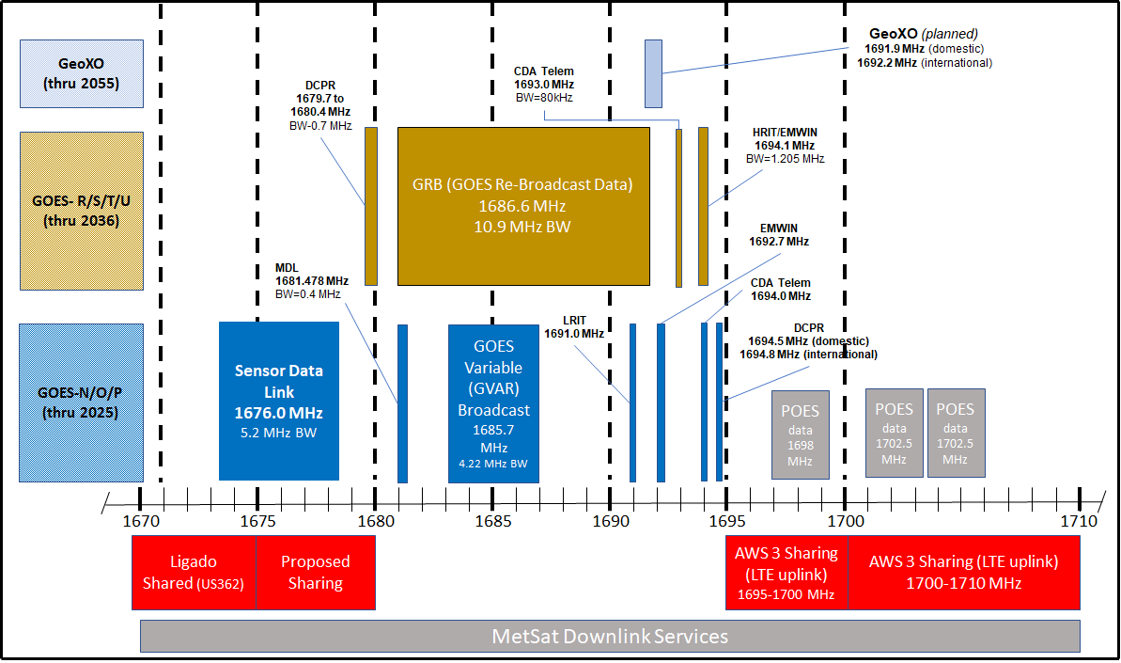
MetSat Downlink Services

Slide 6
Initial SPRES Outcomes
The SPRES resulted in four specific outcomes:
Evaluation of alternative data distribution architectures
Initial analysis showed DCS Administration and Data Distribution System (DADDS) provides the simplest distribution architecture providing high data availability to end-users
Alternative GOES downlink design recommendations
Combinations of various technologies that may be leveraged to meet GOES-NEXT requirements (e.g., modifying the dish antenna feed to reduce RFI from the horizon)
GOES receive site RFI monitoring approaches
Items to consider: Sub-noise detection and classification, angle of arrival determination, aggregate RFI performance, real-time capabilities of monitoring system, and notifications to wireless carriers
The ideal monitoring solution will incorporate near real-time measurements, automation, and data management through spectrum operators
GOES downlink protection mechanisms and RFI mitigation methods
Protection mechanisms are location-specific
Sharing rules are driven by population density, commercial deployment type, severity of anomalous propagation, terrain effects

Slide 7
SPRES-FO
Why the Spectrum Pipeline Relocation Engineering Study – Follow On
The initial Spectrum Pipeline Relocation Engineering Study provided a range of technical measurements and analysis for NTIA and the FCC to make objective decisions about the ability of NESDIS and NOAA to accommodate spectrum sharing in the band
Initial SPRES also recommended areas for further studies
However, FCC and NTIA wanted a definitive solution on how the 1675-1680 MHz band can be shared.
NTIA requested additional guidance and further study to reach a conclusion on feasibility and specific implementation details for sharing the 1675-1680 MHz band

Slide 8
SPRES-FO Objectives
Task 1 – Assess the feasibility of using an alternative DCS downlink site
Build on original SPRES recommendations and findings to develop alternative operating concepts
Build ROM costs and schedule estimation
Task 2 – Evaluate alternatives for the redistribution of DCS data
Identify technical requirements such as data availability and IT infrastructure characteristics
Develop ROM costs and schedule estimation
Task 3 - Identify Regulatory Constraints (NTIA)
Develop a model to perform interference analysis to identify regulatory constraints needed to protect mission-critical sites.
Task 4 – Validate the locations and characteristics of mission-critical DCS, GRB, and HRIT sites
SPRES-FO will examine a list of federal/non-federal mission-critical stations

Slide 9
SPRES-FO Status
SPRES-FO Interim Report delivered to NESDIS on October 15
Report distributed to relevant NESDIS offices and NOAA CIO for review
Other DCS stakeholders are also reviewing:
U.S. Army Corps of Engineers,
Bureau of Land Management,
Department of Interior
Bureau of Reclamation
Department of Transportation
Review due date – November 20
Delivery of final report – December 5

Slide 10
Recommendations Task 1 – Alternative DCS downlink site
Due to CBU’s low implementation costs and favorable RF propagation conditions, CBU should be used concurrently with WCDAS to combat RFI risks
Fairmont, WV does not experience the same anomalous propagation effects as Suitland and WCDAS, due to its inland location and substantial terrain environment.
To maintain commercial wireless characteristics
A database of commercial network parameters will provide insight to the frequency usage as a function of location by the commercial network.
NOAA to determine the DCS data quality received under normal operating conditions.
A database of historical values should be maintained to aid in future coordination efforts to represent cases of data degradation as a function of time.

Slide 11
Recommendations Task 2 – Alternative DCS Distribution Method
Overlay a new file server system with dedicated infrastructure over NOAA’s local networks within WCDAS and NSOF
This would create a high availability and failover concept between WCDAS and NSOF leveraging the existing N-Wave VPLS network, allowing fast and reliable communications between sites.
File server system between WCDAS and NSOF would allow direct interfacing of end users, (USACE and DOI), to retrieve DCS raw files.
A secondary approach is a Cloud-based equivalent of the file server system linked to the NOAA premise-based file system over direct connect links.
DCS end users use any industry standard connections to reach NOAA’s premises and the cloud services to retrieve the copies of the raw DCS data from the file servers by establishing connections via internet service providers
The ability to retrieve, store, and disseminate the raw DCS data file allows DCS end users to retain their current processes and mitigate the impact of RFI experienced at the DRGS.

Slide 12
Recommendations Task 3 – Identify Regulatory Constraints (NTIA)
Task 3 analysis was conducted by the NTIA
NESDIS ACIO coordinated with NTIA to establish the ground station and commercial network parameters used in the SPRES-FO link budget.
The application of the SPRES-FO link budget parameters differs compared to how the parameters were applied in the original SPRES analysis.
The objective of the original SPRES analysis was to develop protection zones rather than coordination zones.
Dynamic and Static Coordination Zones were assessed
With static protection zones, downlink spectrum sharing in the 1675–1680 MHz band must choose a single protection zone for each location that does not change.
With a dynamic protection zone, the protection zone area would vary based on propagation conditions.
Static sharing using coordination zones establishes regions surrounding a GOES downlink site where proposed deployments of commercial networks require pre-deployment approval.
Dynamic sharing using coordination zones as considered here establishes fixed coordination zones for key GOES processing sites while providing for conditional protection zones for all other DCS sites that enable dynamic access. The discussion here focuses on those sites where dynamic sharing would be implemented.
NTIA’s report with above options is being reviewed by other Federal Agencies.

Slide 13
Recommendations Task 4 - Validate locations and characteristics of mission-critical DCS, GRB, and HRIT sites
Limitations encountered in identifying the DCS and GRB users
Recommend current and future GOES receive sites are registered with the NOAA program offices.
If possible, DRGS manufacturer Microcom, reports device sales with appropriate considerations of the end-users’ proprietary information.
The same suggestion holds for Quorum who produce the GRB receivers
Due to the DCS RFI risks (particularly for the lower-edge DCS channels), it is recommend users implement HRIT receivers as backup
To determine corresponding mission impacts because of the anticipated HRIT migration to a non-spectrum-based solution in the mid-2030s.
Similar assessments should be made by GRB users who are expected to primarily receive their data through a cloud-based solution.
The analysis encountered limitations in the study due to the inability of end-users to concretely describe what their service level requirements are for a terrestrial-based data distribution mechanism.
It is recommended that the findings in Task 2 of SPRES-FO are communicated with end-users. The end users should determine if the performance of alternative data distribution mechanisms meets their mission requirements.

Slide 14
Thank You

